Slide 1
Cooperating Classes
Very Simple Example

Slide 2
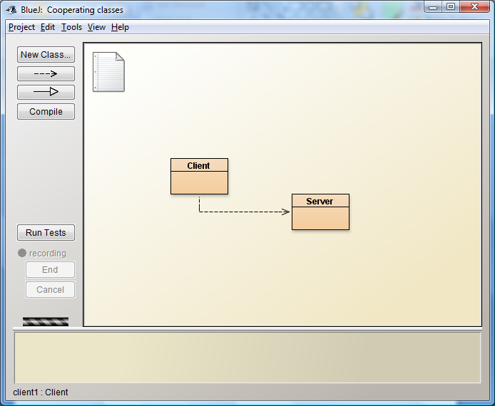
The System

Slide 3
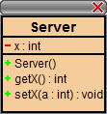
Server Holds some data

Slide 4
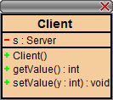
Client sets and gets values from Server

Slide 5
public class Server
{
private int x;
public Server()
{
x = 0;
}
public void setX( int a)
{
x = a;
}
public int getX()
{
return x;
}
}
public class Client
{
private Server s;
public Client()
{
s = new Server();
}
public void setValue(int y)
{
s.setX(y);
}
public int getValue()
{
return s.getX();
}
}

